Slide 1
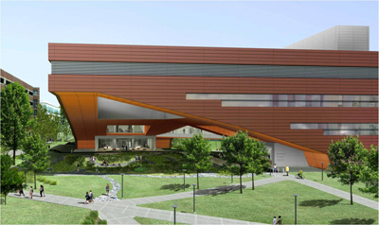

BIMception BIM Execution Plan
Thomas Villacampa
Alexander Stough
Christopher Russell
Stephen Pfund

Slide 2
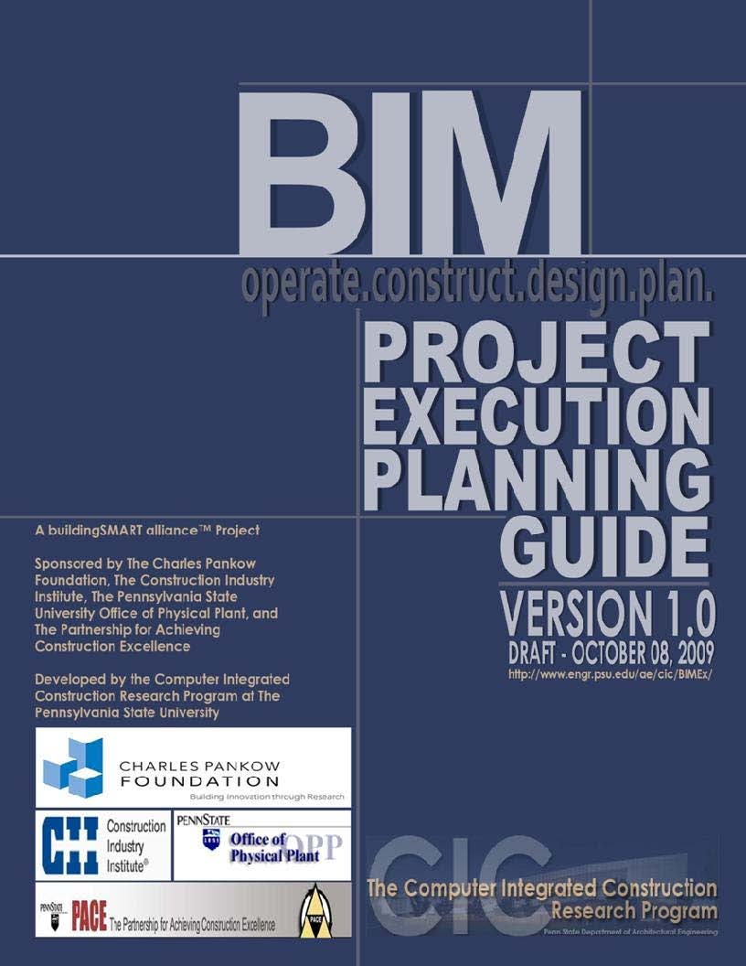

Presentation Outline
Building Overview
BIM Ex Plan Overview
BIM Goals Overview
  BIM Goals
  BIM Uses
BIM Goal/Use Analysis
  Process Maps
  Information Exchange
Project Deliverables
  Scheduling and Formats
Next Step

Slide 3

Building Overview
General Building Information
Owner
  The Pennsylvania State University
Description
  276,000 SF Research Facility housing the Material and Life Sciences
  LEED Certification
Location
  PSU University Park Campus, University Park, PA
Total Cost
  Approximately $215 million
Unique Features
  150-foot Cantilever
  Vivarium Space
  Quiet Labs
  Nano-Clean Rooms

Slide 4
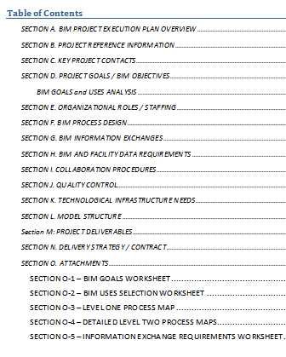
BIM Execution Plan Overview
Integrative Project Delivery
  Mutual agreement/contract
Need proper foundation
  BIM Processes
  Information Exchange
  Collaboration Techniques
  Project Deliverables
Execution of Group BIM Goals
  PSU BIM Ex Planning Guide- CIC Research
  Organization: Goal – Use – Process
  BIM GOALS and USES ANALYSIS added

Slide 5
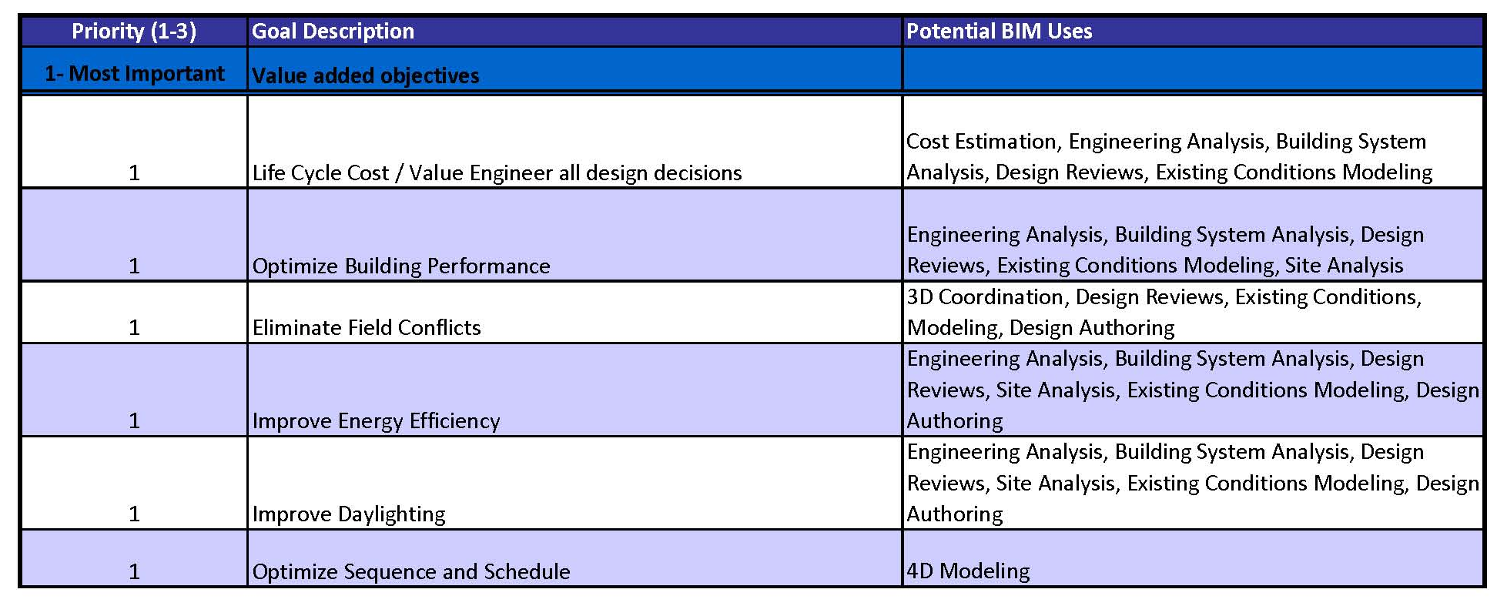
BIM Goals Overview

Slide 6
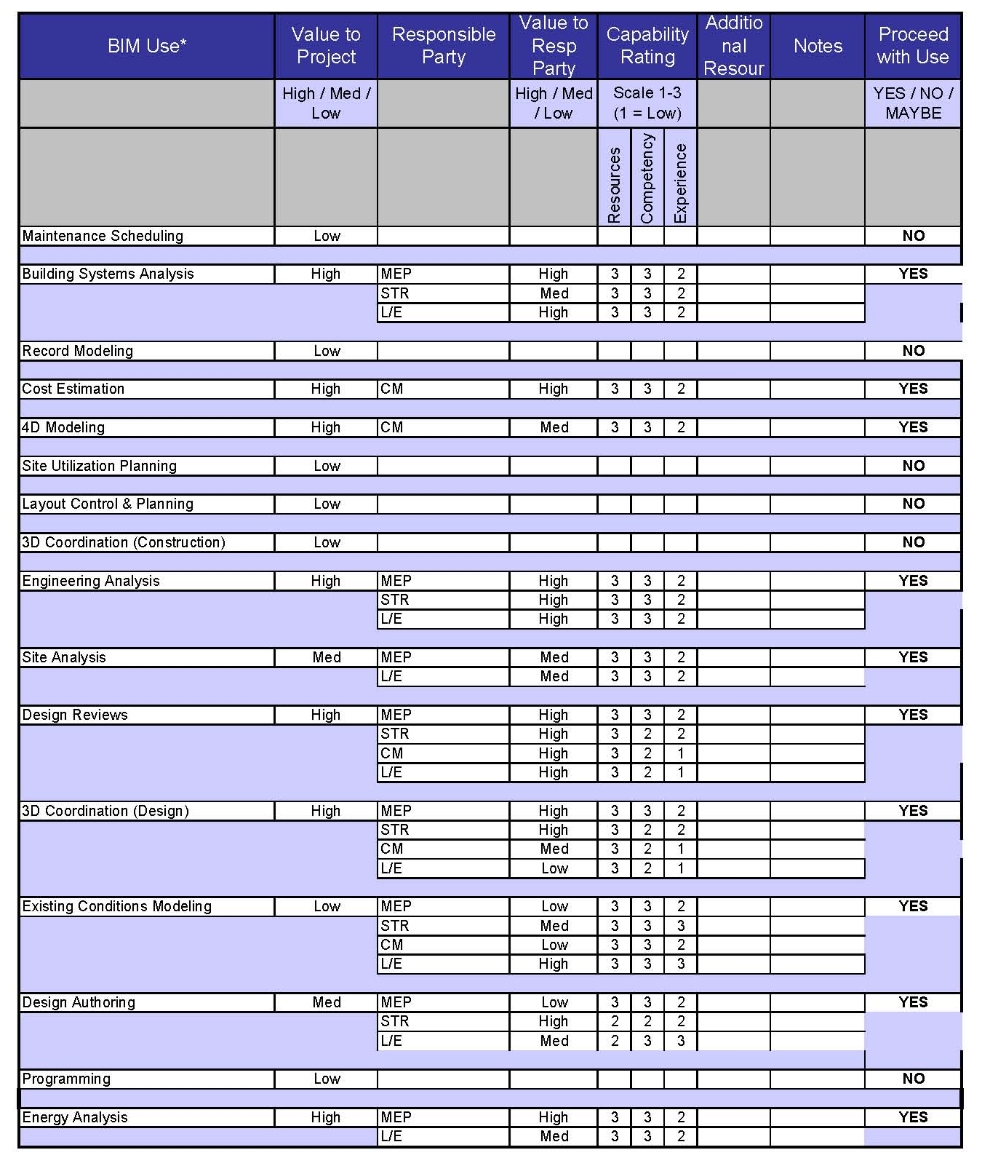
BIM Uses

Slide 7
BIM Goal-Use-Process Analysis Example
Life Cycle Cost/Value Engineering
  Utilize engineering design to select the best integrated design that provides MSC with life cycle and value effective building solutions

Slide 8
CM Life Cycle Cost Overview
Overview of Goal
  Produce a more efficient building through integrated design with a lower overall cost to the owner
Why Life Cycle Cost?
  Value Engineering to produce a lower overall cost
  Upfront Cost vs. Life Cycle Cost
Construction Management Contribution
  Upfront Cost Estimation
    Current Design and Redesign
  Value Engineering Input
BIM Uses
  Quantity Take-Offs
    Autodesk QTO
    Autodesk Revit

Slide 9
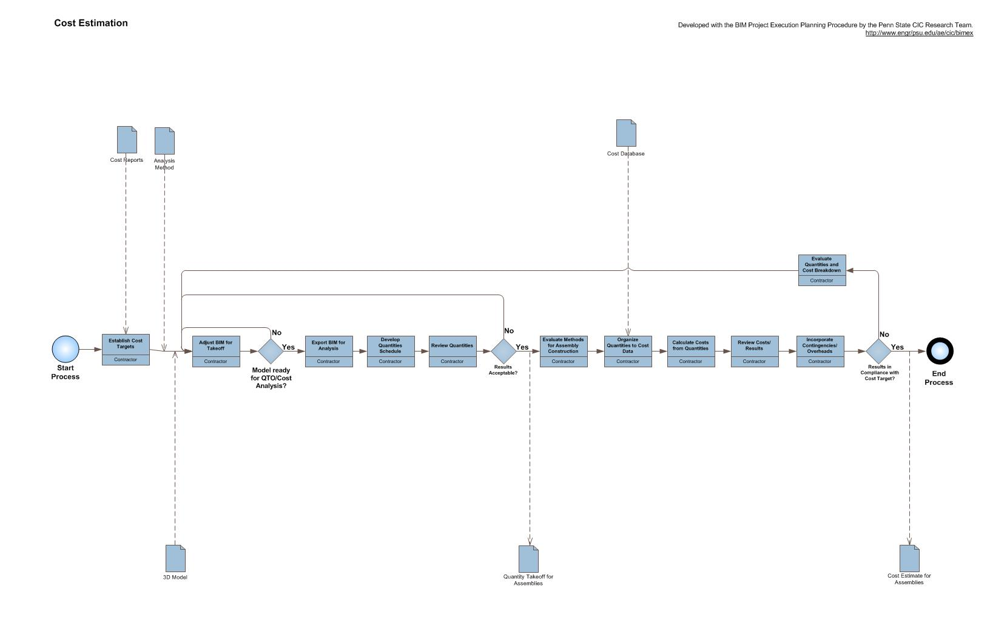
CM Life Cycle Cost Overview

Slide 10
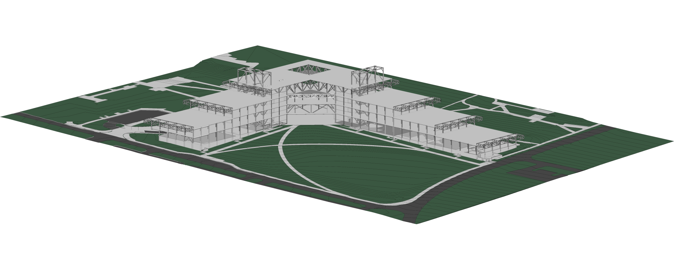
Structural Contribution
Material and Construction Costs
  Materials, Labor, Schedule
BIM USES
  Existing Conditions Modeling
  Structural Analysis/Modeling
  Building Systems Analysis

Slide 11
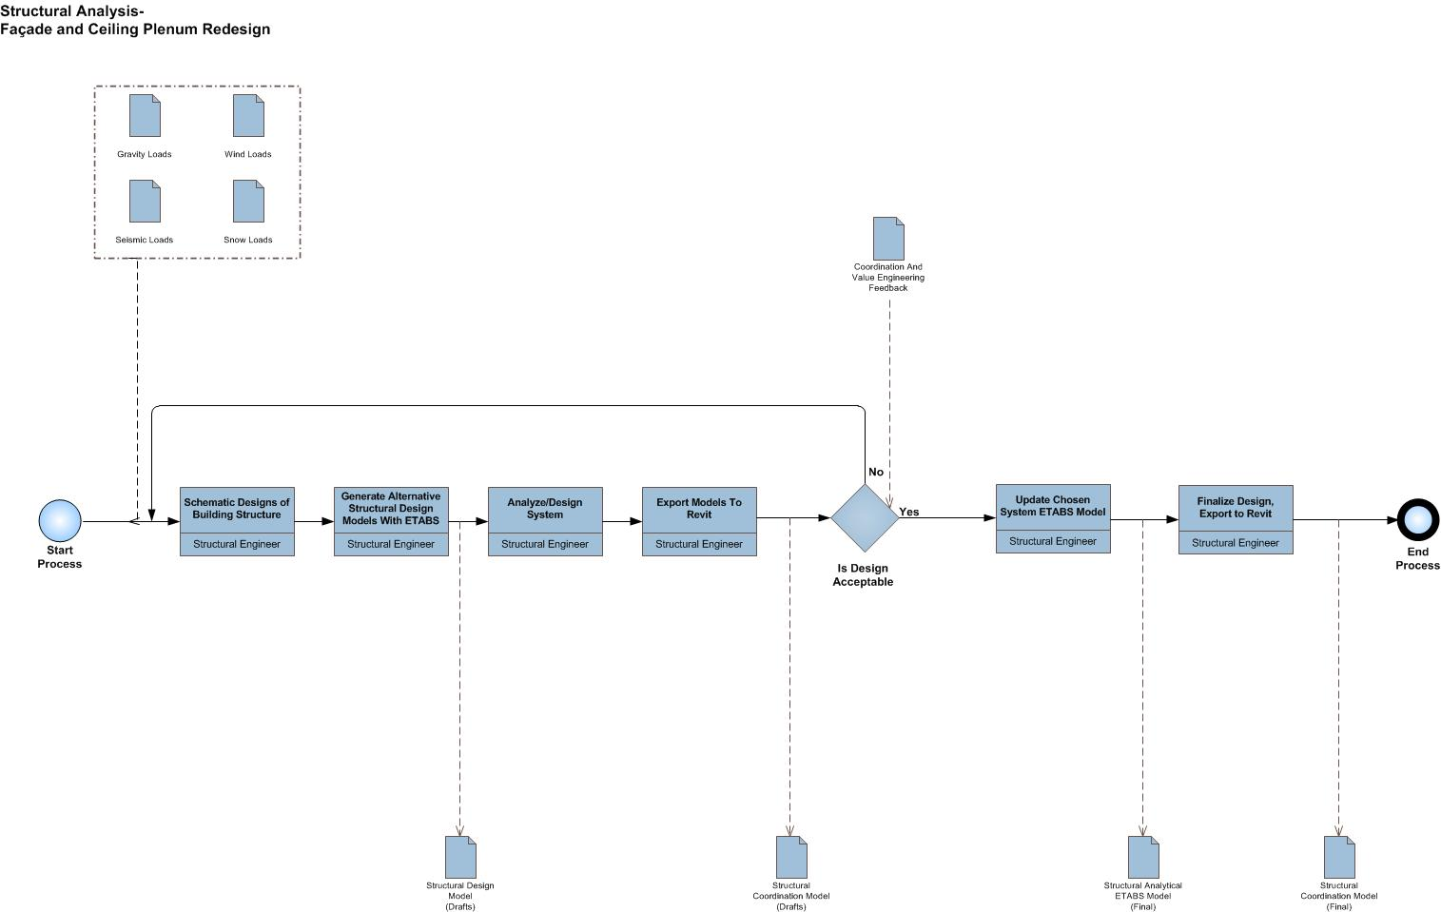

Slide 12
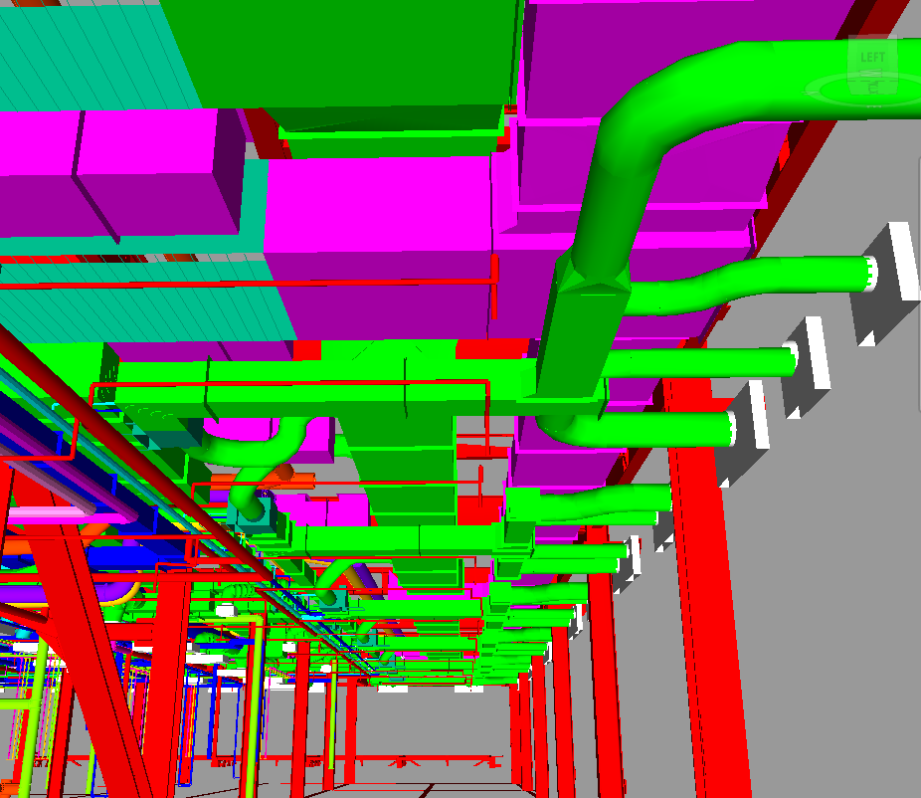
Mechanical Contribution
Up-front vs. Operational Cost Savings
System Performance Comparisons
Integrated Iterations
BIM USES
  Existing Conditions Modeling
  Mechanical Analysis/Modeling
  Building Systems Analysis
  Design Reviews

Slide 13
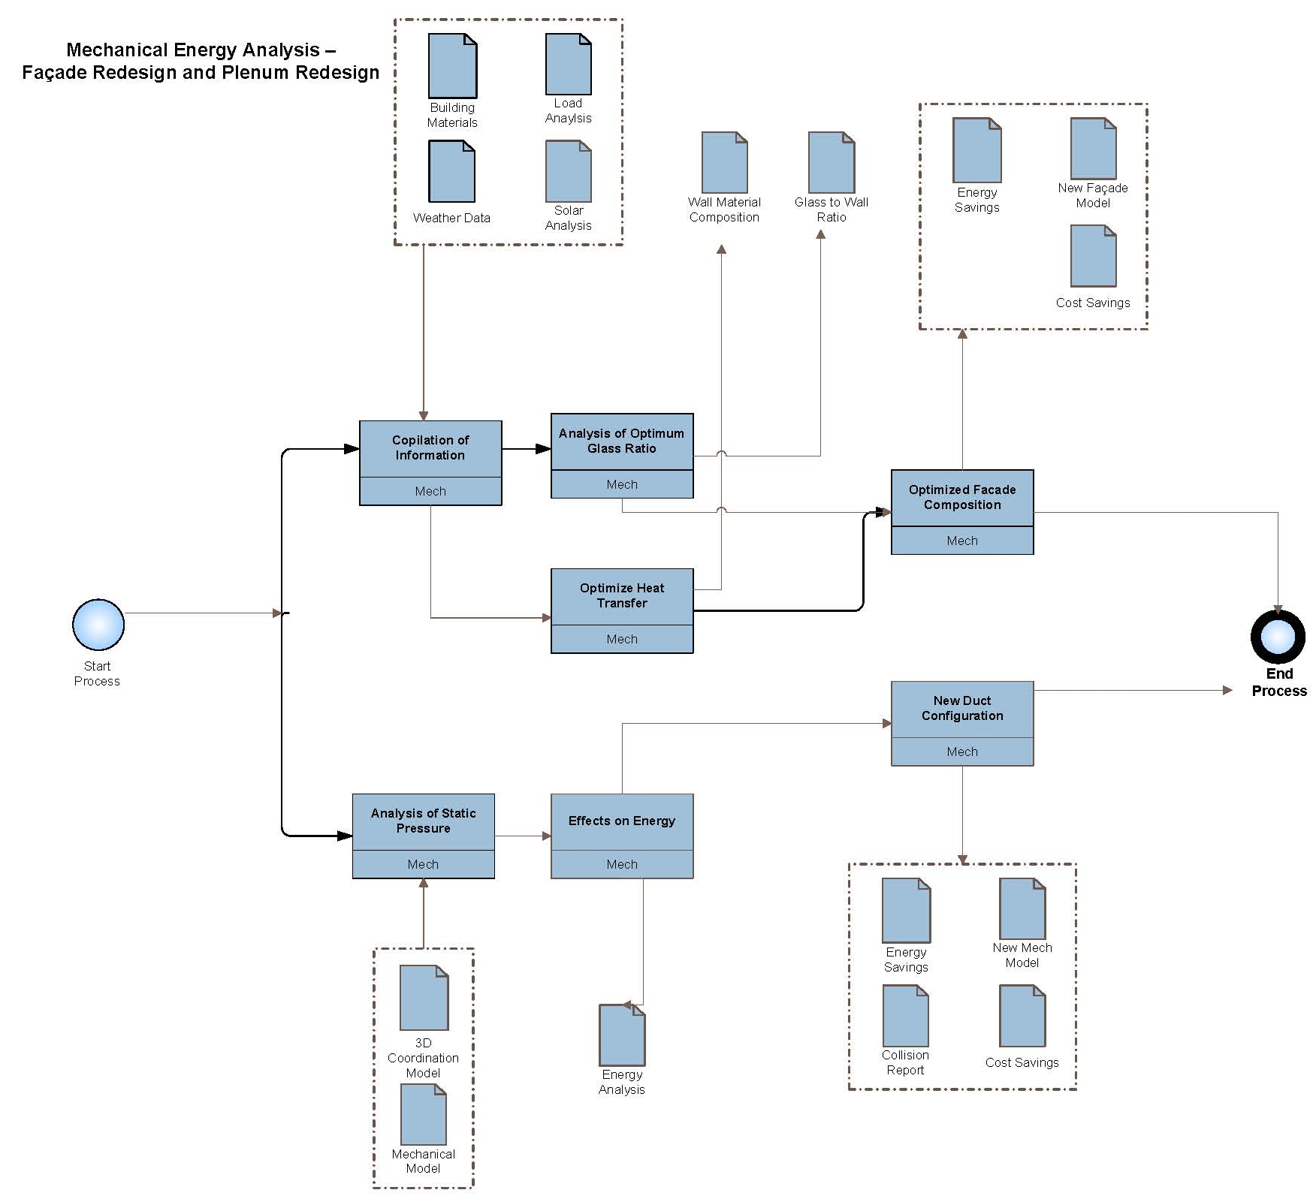

Slide 14
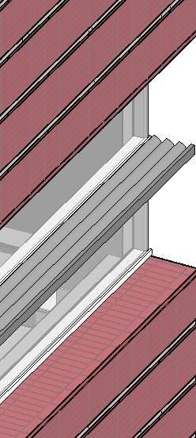
Lighting/Electrical Contribution
Material Costs
  Fixture Control, Glazing material
BIM USES
  Existing Conditions Modeling
  Building Systems Analysis

Slide 15
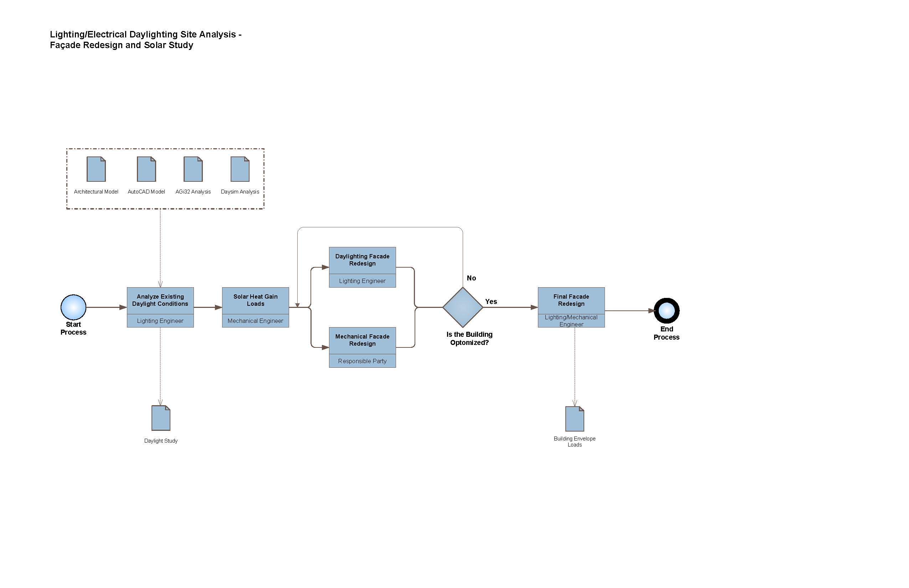

Slide 16
Project Deliverables
INFORMATION EXCHANGE | FILE SENDER | FILE RECIEVER | FREQUENCY | DUE DATE | MODEL FILE | MODEL SOFTWARE | NATIVE FILE TYPE | FILE EXCHANGE TYPE
MEP COORDINATION MODEL | TEAM | TEAM | MONTHLY | APRIL | .rvt .nwd | PERIODIC | WEEKLY | .rvt
ENERGY ANALYSIS REPORTS | ME,LE | ME,LE | WEEKLY | APRIL | .trc .hea | PERIODIC | WEEKLY | .trc, .hea
STRUCTURAL ANALYSIS REPORTS | SE | CM | WEEKLY | FEB | .EDP | PERIODIC | WEEKLY | .EDP
DESIGN PROGRESS | TEAM | TEAM | WEEKLY | CONT. | .doc .xls | PERIODIC | WEEKLY | .doc.xls
BIM SUBMITTAL ITEM | STAGE | APPROX. DUE DATE | FORMAT | NOTES
FAÇADE MODEL | DD,CD | April 2011 | REVIT
ENERGY ANALYSIS REPORT | DD,CD | April 2011 | TRACE
DAYLIGHTING REPORT | DD,CD | January-February 2011 | DAYSIM, AGi32
STRUCTURAL REPORTS | DD,CD | January-February 2011 | ETABS
COST ESTIMATION | DD,CD | February-March 2011 | EXCEL
4D MODEL | CD | April 2011 | NAVISWORKS
3D COLLISION MODEL | CD | April 2011 | NAVISWORKS
LIGHTING DESIGN MODEL | DD,CD | April 2011 | AGi32, 3ds Max Design

Slide 17
Next Step
Revision of Alternative Redesigns
Incorporation of BimEx Plan
Semester Proposal

Slide 18
Thank you for listening
Can we answer any questions?

Slide 19
Appendices

Slide 20
BIM GOAL | DESCRIPTION | COMPLETE
Life Cycle Cost/ Value Engineer All Design Decisions | Utilize engineering design to select the best integrated design that provides MSC with life cycle and value effective building solutions | no
Optimize Building Performance | Use integrated design to enhance the operation of all building systems | no
Eliminate Field Conflicts | Collaboratively design the plenum to best take advantage of the vertical dimension of the ceiling plenum | no
Improve Energy Efficiency | Create energy savings based on the existing design model | no
Improve Daylighting | Optimize the building’s daylighting system with respect to cost and increased envelope loads. | no
Optimize Sequence and Schedule | Create an efficient sequence of trades to properly construct a redesigned building | no

Slide 21
BIM USE | COMPANY | NUMBER OF TOTAL STAFF FOR BIM USE | ESTIMATED WORKER HOURS | LEAD CONTACT
SITE ANALYSIS | BIMception | 2 | TBD | Chris Russell Alex Stough
EXISTING CONDITIONS MODELING | BIMception | 4 | TBD | Chris Russell Alex Stough Steve Pfund Tom Villacampa
DESIGN AUTHORING | BIMception | 3 | TBD | Chris Russell Alex Stough Steve Pfund
DESIGN REVIEWS | BIMception | 4 | TBD | Chris Russell Alex Stough Steve Pfund Tom Villacampa
STRUCTURAL ANALYSIS | BIMception | 1 | TBD | Steve Pfund
LIGHTING ANALYSIS | BIMception | 1 | TBD | Chris Russell
ENERGY ANALYSIS | BIMception | 1 | TBD | Alex Stough
MECHANICAL ANALYSIS | BIMception | 1 | TBD | Alex Stough
4D MODELING (DESIGN) | BIMception | 1 | TBD | Tom Villacampa
COST ESTIMATION (DESIGN) | BIMception | 1 | TBD | Tom Villacampa
3D COORDINATION | BIMception | 4 | TBD | Chris Russell Alex Stough Steve Pfund Tom Villacampa
4D MODELING (CONSTRUCT) | BIMception | 1 | TBD | Tom Villacampa
COST ESTIMATION (CONSTRUCT) | BIMception | 1 | TBD | Tom Villacampa
BUILDING SYSTEM ANALYSIS | BIMception | 3 | TBD | Chris Russell Alex Stough Steve Pfund
COST ESTIMATION (OPERATE) | BIMception | 2 | TBD | Alex Stough Tom Villacampa

Slide 22
MEETING TYPE | PHASE | FREQUENCY | PARTICIPANTS | LOCATION
3D MEP COORDINATION | CONSTRUCTION | MONTHLY | ALL | BIM ROOM
DESIGN REVIEW | DESIGN | WEEKLY | ALL | BIM ROOM
COST ANALYSIS | DESIGN | TRI-WEEKLY | ALL | BIM ROOM
ENERGY ANALYSIS | DESIGN | TRI-WEEKLY | ALL | BIM ROOM
INFORMATION EXCHANGE | FILE SENDER | FILE RECIEVER | FREQUENCY | DUE DATE | MODEL FILE | MODEL SOFTWARE | NATIVE FILE TYPE | FILE EXCHANGE TYPE
MEP COORDINATION MODEL | TEAM | TEAM | MONTHLY | APRIL | .rvt .nwd | PERIODIC | WEEKLY | .rvt
ENERGY ANALYSIS REPORTS | ME,LE | ME,LE | WEEKLY | APRIL | .trc .hea | PERIODIC | WEEKLY | .trc, .hea
STRUCTURAL ANALYSIS REPORTS | SE | CM | WEEKLY | FEB | .EDP | PERIODIC | WEEKLY | .EDP
DESIGN PROGRESS | TEAM | TEAM | WEEKLY | CONT. | .doc .xls | PERIODIC | WEEKLY | .doc.xls

Slide 23
BIM USE | DISCIPLINE (if applicable) | SOFTWARE | VERSION
DESIGN AUTHORING | ALL | Revit | 2010
ENERGY ANALYSIS | MEP | Trane Trace, Excel, Daysim
3D COORDINATION | CM, MECH | NavisWorks Manage | 2011
4D MODELING | CM | NavisWorks Manage | 2011
STRUCTURAL ANALYSIS | STRUCT | ETABS | 9
LIGHTING ANALYSIS | L/E | AGi32, 3ds Max Design, AutoCAD
BIM SUBMITTAL ITEM | STAGE | APPROX. DUE DATE |  |  | FORMAT | NOTES
FAÇADE MODEL | DD,CD |  | April 2011 | REVIT
ENERGY ANALYSIS REPORT | DD,CD |  | April 2011 | TRACE
DAYLIGHTING REPORT | DD,CD |  | January-February 2011 | DAYSIM, AGi32
STRUCTURAL REPORTS | DD,CD |  | January-February 2011 | ETABS
COST ESTIMATION | DD,CD |  | February-March 2011 | EXCEL
4D MODEL | CD |  | April 2011 | NAVISWORKS
3D COLLISION MODEL | CD |  | April 2011 | NAVISWORKS
LIGHTING DESIGN MODEL | DD,CD |  | April 2011 | AGi32, 3ds Max Design

Slide 24
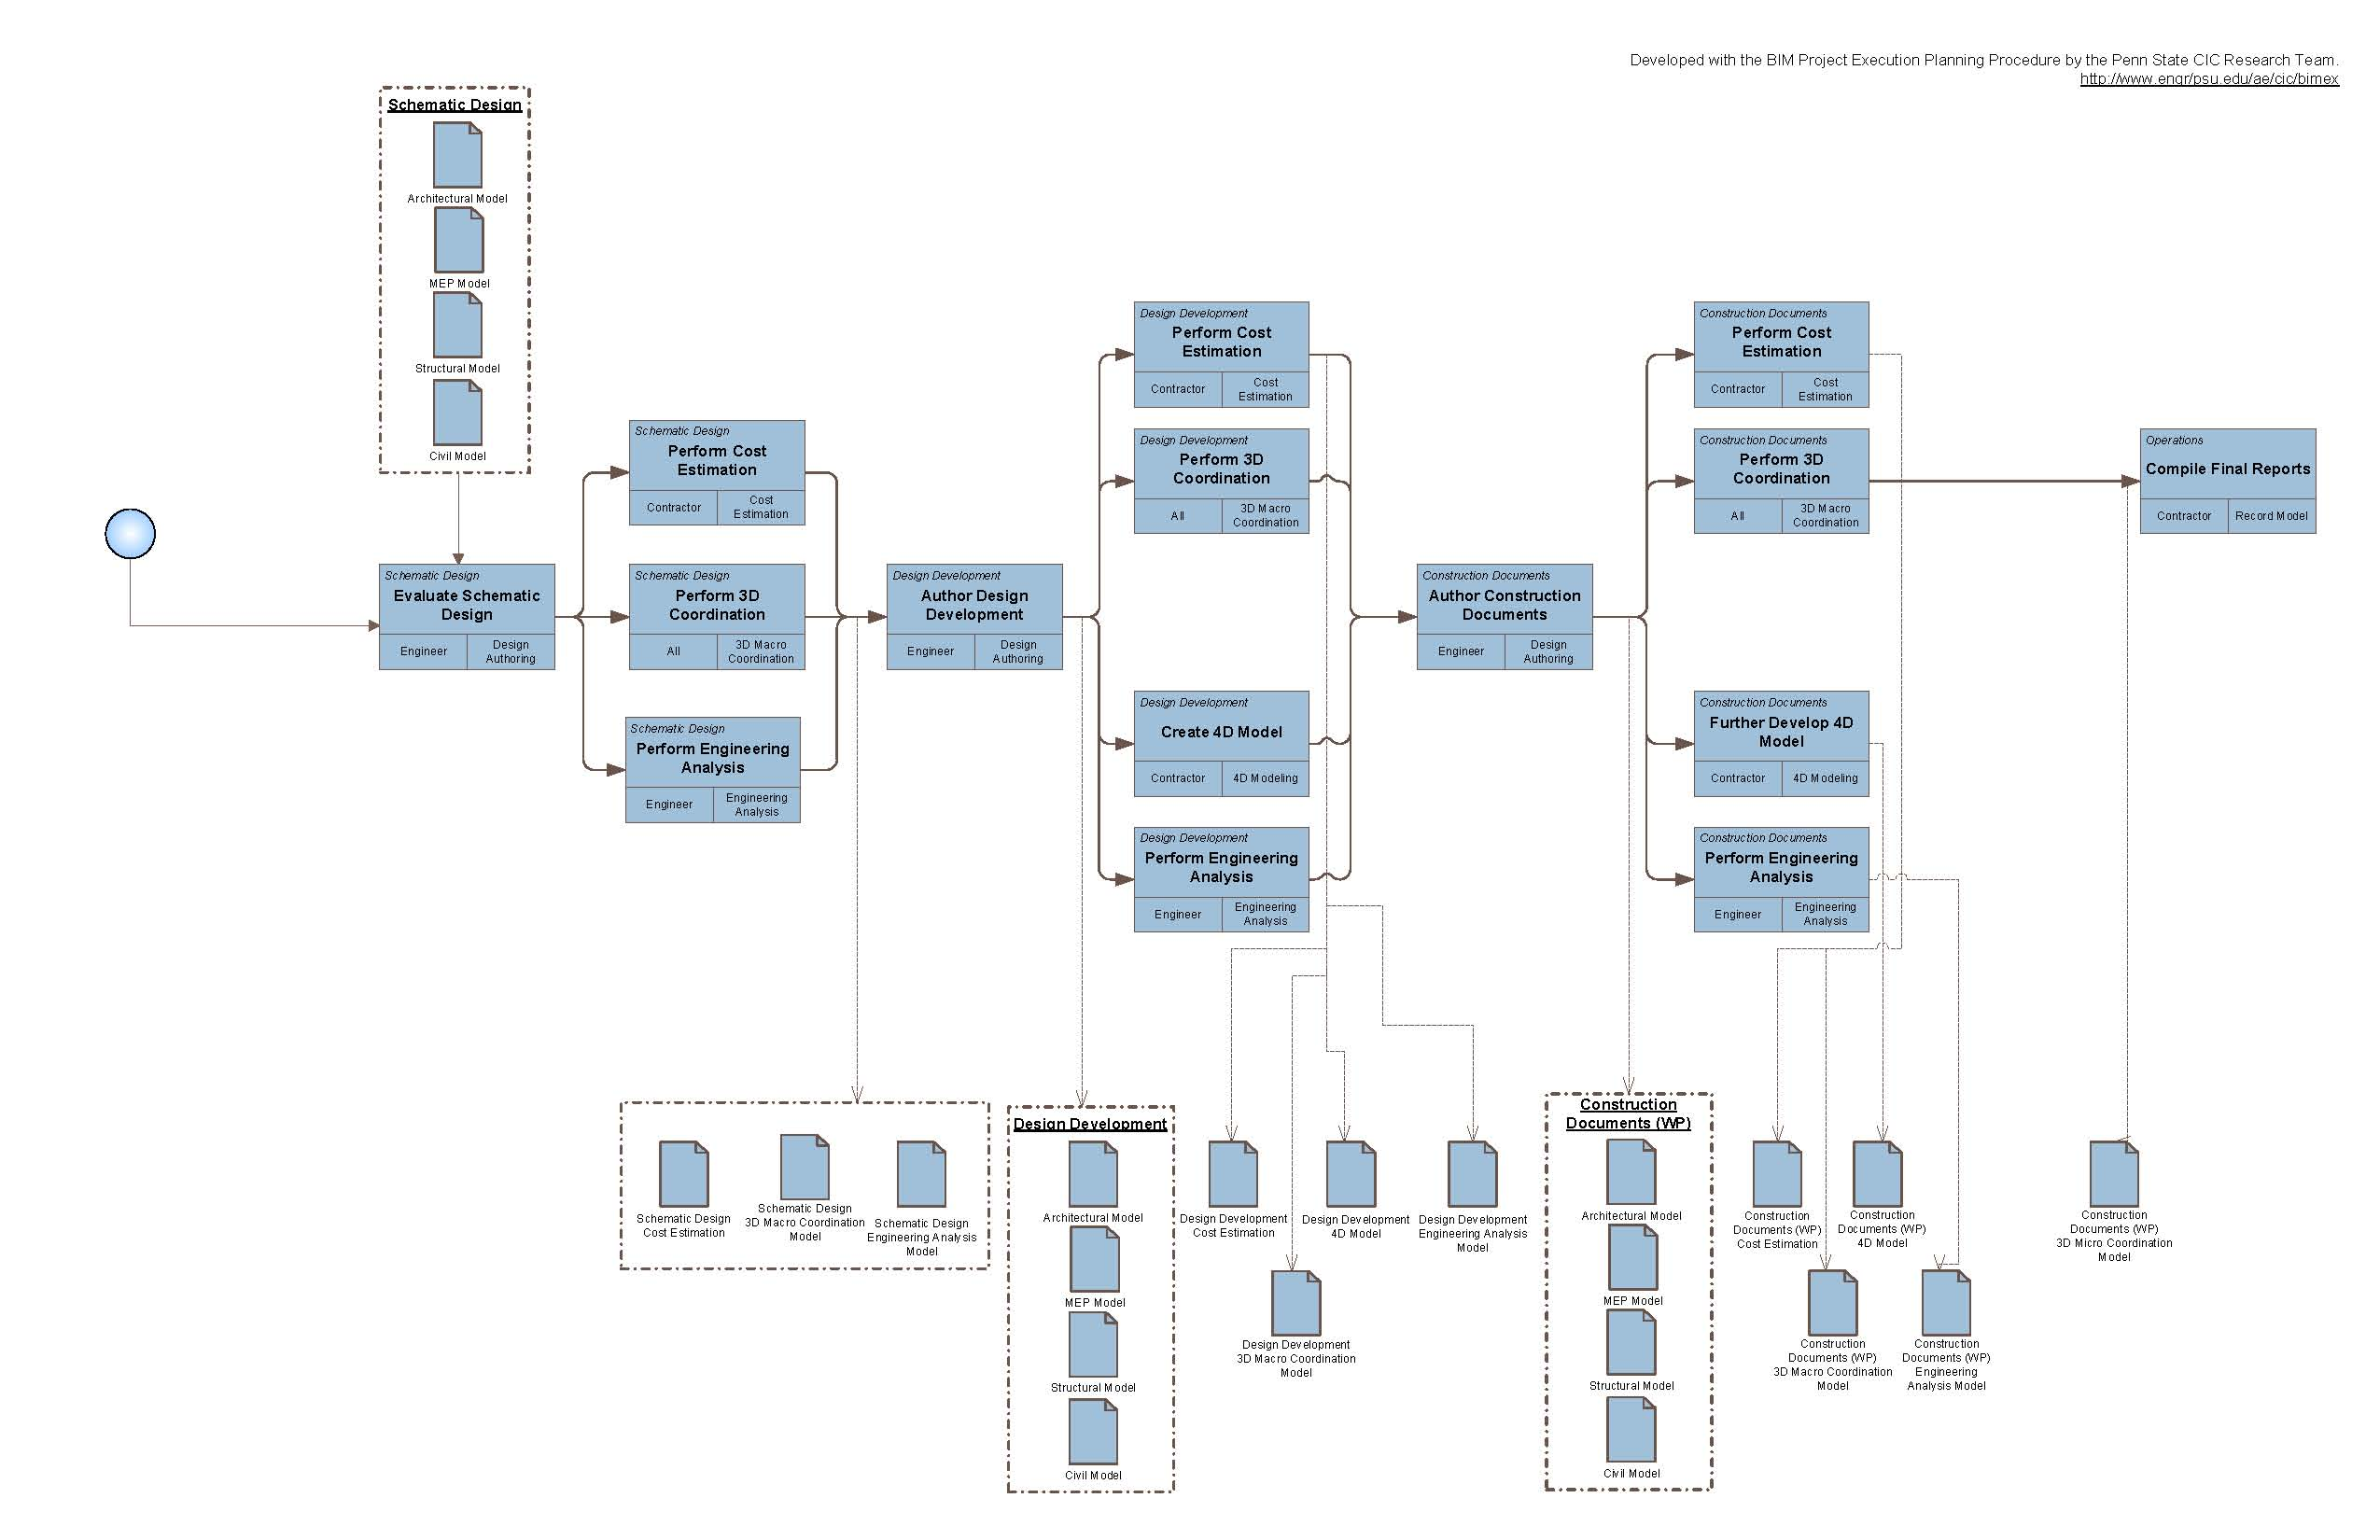

Slide 25
